Slide 1



Slide 2
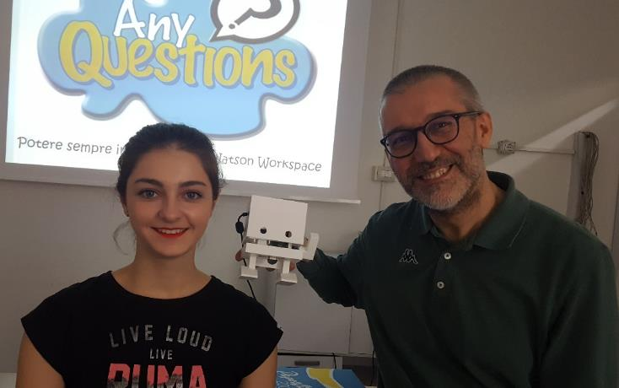
This document extends and integrates IBM Volunteers Activity Kit and many other information available on TJBot. It’s a work in progress born to support activities performed at I.I.S. Galileo Galilei di Crema (CR), a secondary state school with about 1,900 students aged 14-19 working in two fields of education: “Applied Sciences high school” and “Technological high school”.
Legend
Just Formatted slide
Modified slide
New slide
Table of contents:
TJBot introduction
How to setup TJBot (updated March 2018)
Play with TJBot powered by ready to use recipes
Compose TJBot behavior using Node-Red
Program TJBot using Node.js
Zero to Master in TJBot programming
Expanding TJBot capabilities
TJBot browser simulator
Virtual TJBot programming
Troubleshooting
Thanks Giulia! TJBot finally wears a 3D dress!
All the credits belongs to TJBot team and fans around the world. I got everything I can from your activities.
Thanks to everyone that answered my newbie questions on slack, email, sametime, by person, and to everybody that will update, integrate and fix up all the things I’ve understood or missed.
Please share you updates, and let TJBot grown up! Ferruccio Manclossi, March 2018

Slide 3
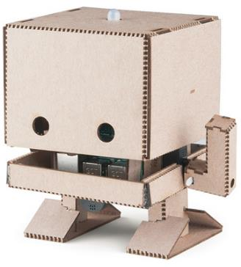
What's possible with AI – TJBot: Introduce students to cognitive technologies and AI by helping them build a simple robot, and then bring it to life using any available Watson™ service. You can order a kit online or download instructions to make TJBot using 3D printing or laser-cutting a cardboard template. To make it even easier to use TJBot to teach programming, there is now a virtual version.
Who is the Audience?
Ages 11-14 (Middle grade students)
Ages 14-19 (Secondary/high school students)
What’s the Goal of this Activity Kit?
Introduce cognitive technologies and programming.
Explore “embedded cognition” – everyday objects that use AI to interact with us.
Why is this Topic Important?
The technologies introduced through this activity have a growing impact in our world.
A fun, creative, hands-on project is an ideal way to stimulate students’ interest in STEM topics.
What do I Need to Know about this Topic?
Volunteers should be comfortable with technical projects, and experience with Raspberry Pi and/or Swift is ideal. Additional involved technologies could be Node.js, Node-Red…
What’s the Commitment? Building a physical TJBot requires the purchase of a kit (where available) or separate components.
Helpful Checklist:
Is your activity based upon physical or virtual TJBot? If virtual, skip everything, but keep in mind that you’ll get minor impact.
Do you have enough time to acquire and test TJ Bot (and Raspberry Pi) components?
TJBot clothes: 3D print, laser cut or self made?
Is it a standard TJBot activity or you leave room to expand/integrate/modify current TJBot architecture?
Resources:
You might find the #tjbot Slack channel at IBM very helpful
The original blog post introducing TJBot, by Maryam Ashoori: ibm.com/blogs/research/2016/11/calling-makers-meet-tj-bot/
TJ Bot video tutorial by a young student user Tanmay Bakshi– IoT: Discussing Watson IoT using the TJ Bot with my mentor, John Cohn! https://yourlearning.w3bmix.ibm.com/#activity/URL-1502910233556
You may contact the IBM team at tjbot@us.ibm.com with any questions about this project.
Notes:
From IBM Volunteers TJBot Activity Kit
Step-by-Step
Review the content online about TJBot, including the cost and availability of a kit or components, and decide if you want to conduct this activity with a physical TJBot or a virtual one.
Review the presentation, which is focused on an activity in two parts: building the bot, and then programming it. The second part could be helpful even if you decide to use a virtual TJBot.
Arrange your activity with students.

Slide 4
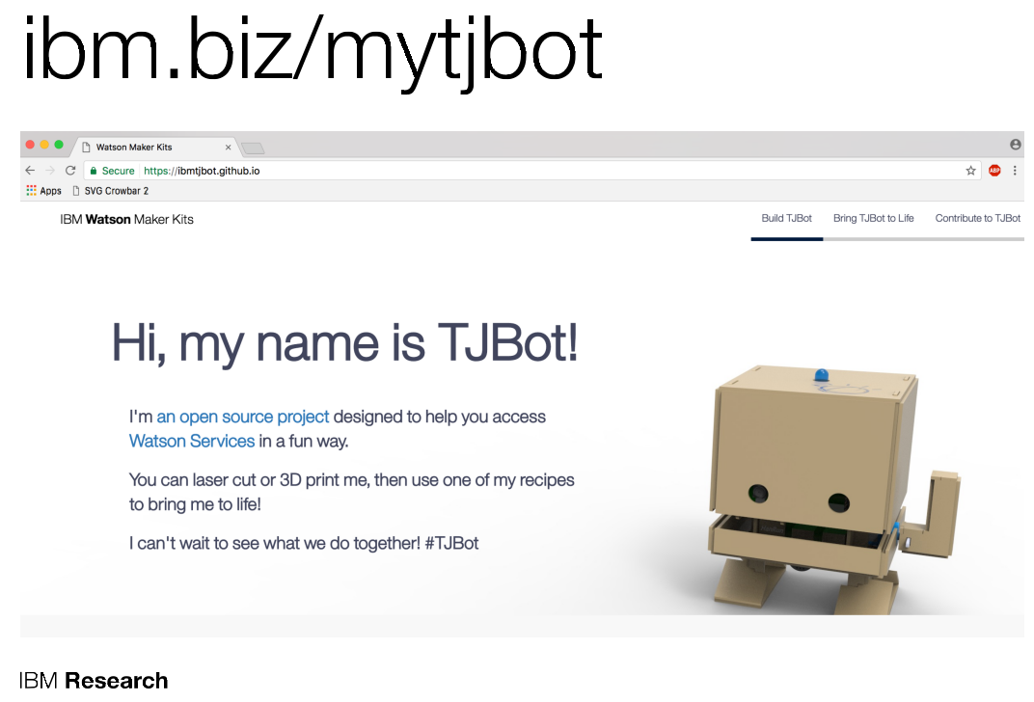

Slide 5
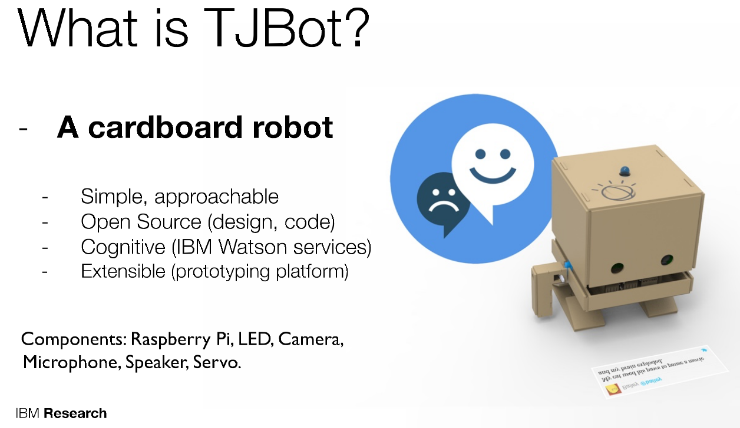

Slide 6
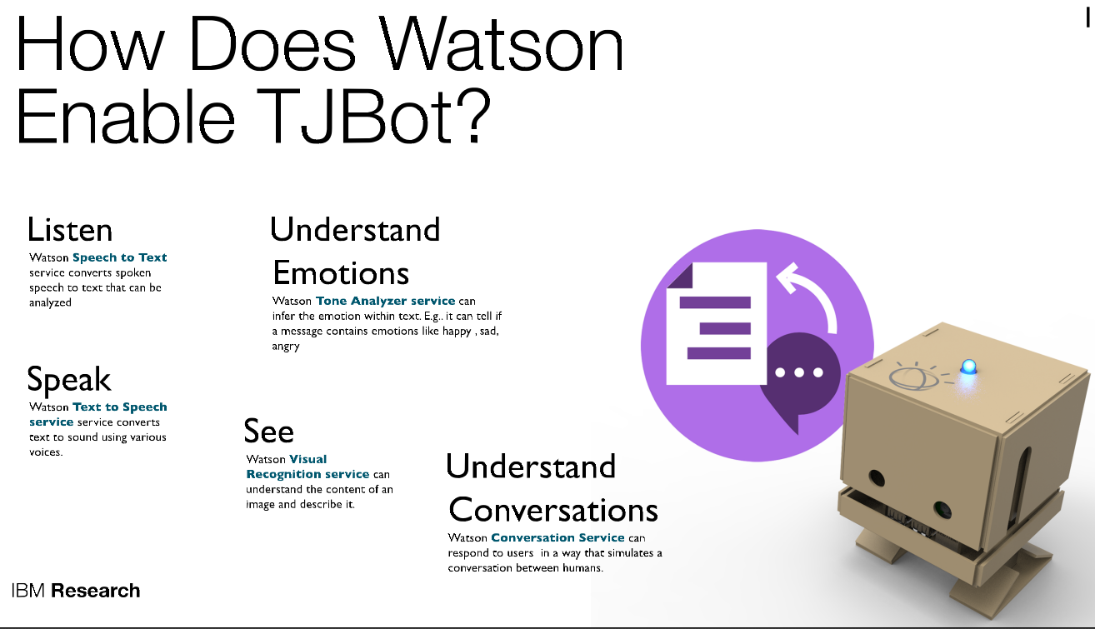

Slide 7
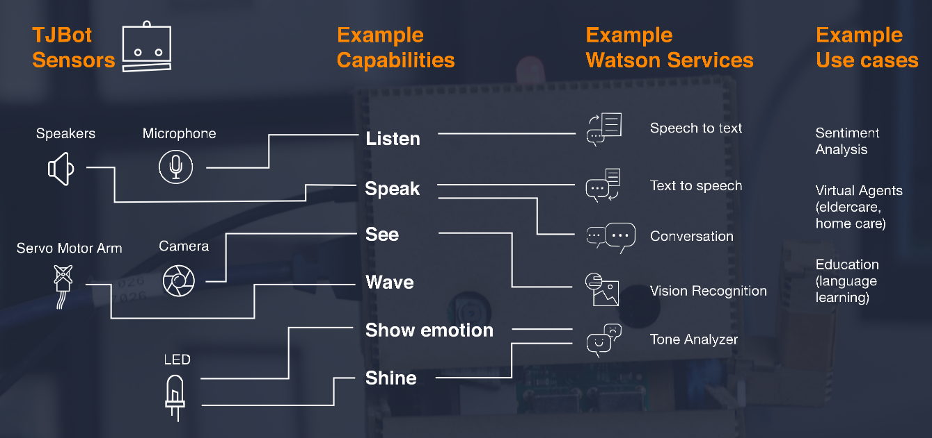
TJBot’s capabilities

Slide 8
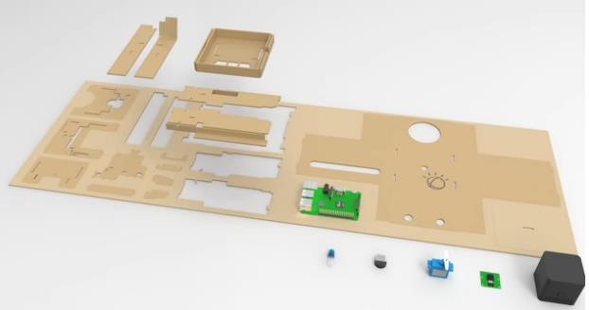
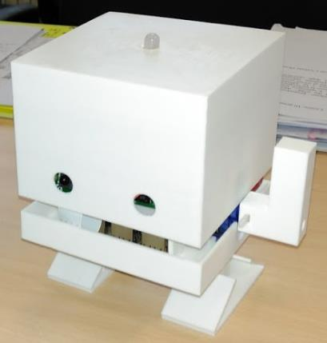
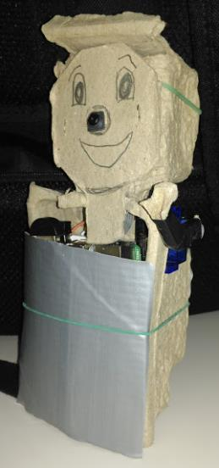
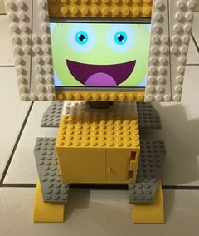
Assemble IBM TJBot from laser-cut cardboard…
or 3D-print it…
or follow your inspiration!
Notes:
www.youtube.com/watch?v=bLt3Cf2Ui3o

Slide 9
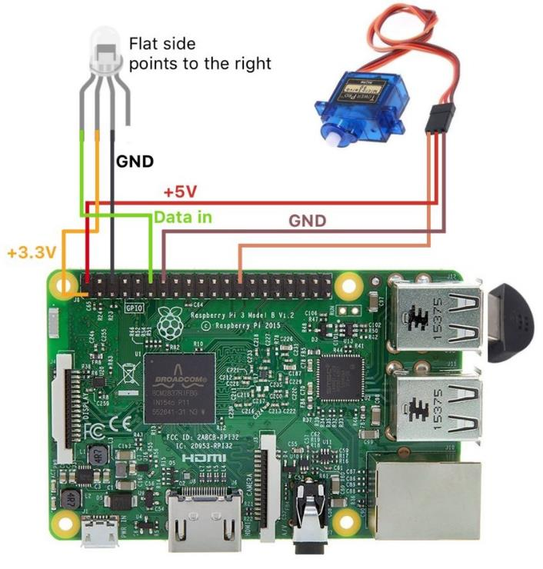

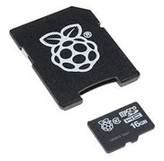
Connecting TJBot components
TJBot Kit (one of many): https://www.adafruit.com/product/3462:
Raspberry Pi 3 Model B
Raspberry Pi Camera Board v2
Micro Servo
Mini USB Microphone
Mini External USB Stereo Speaker
Female/Female Jumper Wires - 20 x 3"
Female/Male 'Extension' Jumper Wires - 20 x 3"
5V 2.4A Switching Power Supply
NeoPixel Diffused 8mm Through-Hole LED - 5 Pack
16GB Card with NOOBS 2.1
if you’ll plan to use LED and audio -> USB Audio Adapter
Different RGB WS2811 LED could be use, in case read here.
Less wires, more WOWs!!!
USB Microphone. Use a wireless headset for better results
Use USB ports to connect keyboard (wireless is better) and other devices
Put NOOBS 2.1 16GB SD Card in the back
USB 2.0 micro adapter for power supply(2A+)
Ethernet port (Raspberry 3B has WiFi and Bluetooth, too. It can also connect to internet using tethering over USB)
HDMI (use HDMI to VGA adapter for projector or old screens)
Avoid built-in Audio. You get better results with an USB Audio Adapter
Connect Pi Camera Board v2
Notes:
It's very important to make sure you connect the LED to the right pins, otherwise you may damage your LED or the Pi.
Then start with the GND, which is the longest, or the 2nd leg from the right. Connect it with pin # 6 on the board
Then connect Data (the leftmost leg) with pin # 12 on the board
Finally, connect + 3.3V (leg 2 from the left) with pin # 1.
Servo motor
5V -> PIN 2
GND = PIN 14
DATA = PIN 26

Slide 10
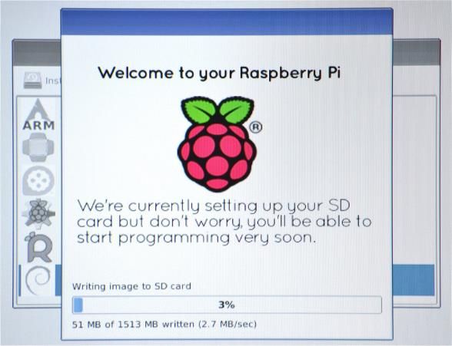
Setup TJBot software (1/2)
First boot: Plug in your keyboard, mouse, and monitor cables. Now plug the USB power cable into your Pi. Your Raspberry Pi will boot, and a window will appear with a list of different operating systems that you can install.
If needed, configure and authorize internet access.
Ticked the box next to Raspbian and click on Install. Raspbian will then run through its installation process. Note that this can take a while. When the install process has completed, the Raspberry Pi configuration menu (raspi-config) will load. Here you are able to set the time and date for your region, enable a Raspberry Pi camera board, enable VNC, SSH or even create users. You can exit this menu by using Tab on your keyboard to move to Finish.
The default login for Raspbian is username pi with the password raspberry.

Slide 11
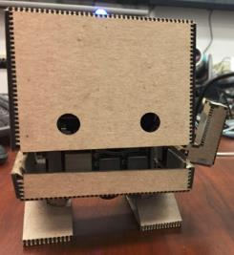

Setup TJBot software (2/2)
Connect to Raspberry (using local keyboard/screen or using VNC/SSH)
install TJ-Bot code (only not default – UPPERCASE - choice) running:
curl -sL http://ibm.biz/tjbot-bootstrap | sudo sh –
(under the hood – check update):
Optional. Set the hostname of your Raspberry Pi (my choice: ASLTJBot)
Optional. Disable ipv6. In some networking environments, disabling ipv6 may help your Pi get on the network. (N)
Optional. Enable Google DNS. In some networking environments, using Google's nameservers may speed up DNS queries. (Y)
Optional. Set the locale to US English (en-US). (N)
Update your Raspberry Pi's operating system software. Note that this can take a while.
Install/update Node.js.
Optional. Which version of Node.js would you like to install? (6)
Optional. Enable the Raspberry Pi camera . (y)
Clone the TJBot project from Git. The default location for the tjbot project is on your Desktop so it is easy to access. You may clone it to any directory you like.
Optional. Disable the audio kernel modules. In order for the LED to work, we need to disable certain kernel modules to avoid a conflict with the built-in audio jack. If you plan to use the built-in audio jack, we recommend NOT disabling the sound kernel modules . (Y)
Restart! (we run the tests after a reboot)
Notes:
If you would like to re-enable the kernel modules for built-in audio, you can do so with the following command.
sudo rm /etc/modprobe.d/tjbot-blacklist-snd.conf
Note: you will need to reboot for these changes to take effect.

Slide 12
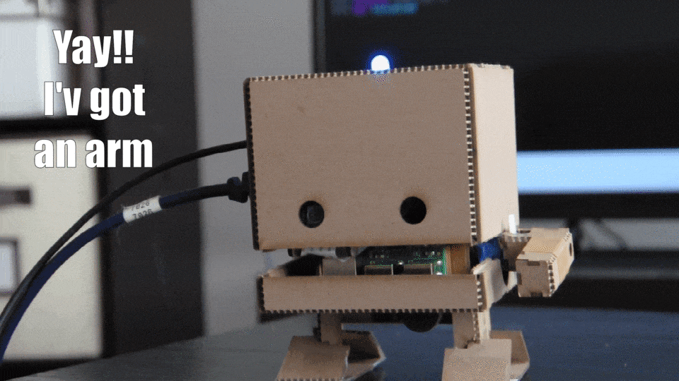

Test TJBot hardware
Connect to Raspberry (using local keyboard/screen, VNC or SSH)
Install TJBot test prerequisite.
This command assumes you have cloned the tjbot git repository to your Desktop.
npm install ~/Desktop/tjbot/bootstrap/tests
Go in bootstrap directory:
cd ~/Desktop/tjbot/bootstrap
Run full comprehensive tests for TJBot:
./runTests.sh
Or Run single test launching specific script:
cd ~/Desktop/tjbot/bootstrap/tests
sudo node test.camera.js
sudo node test.led.js
sudo node test.servo.js
sudo node test.speaker.js
If you experience issues, check troubleshooting session …
or search on internet…
or call your friends!
Notes:
If you would like to re-enable the kernel modules for built-in audio, you can do so with the following command.
sudo rm /etc/modprobe.d/tjbot-blacklist-snd.conf
Note: you will need to reboot for these changes to take effect.

Slide 13
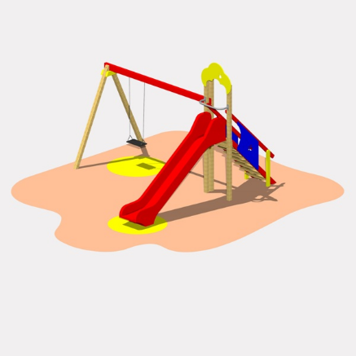

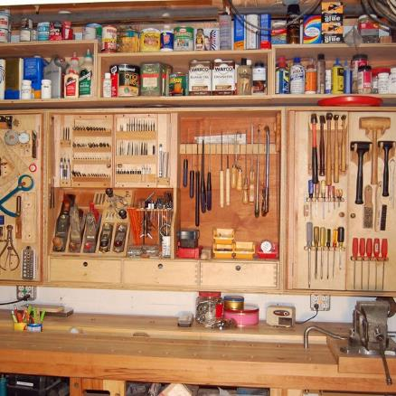

And now, choose your path!!!
Use TJBot with «recipes»
Compose TJBot behavior with «blocks»
Program TJBot
Troubleshooting

Slide 14


“Cook” applying recipes
Recipes are step-by-step instructions to bring your TJBot to life:
Use Your Voice to Control a Light with Watson
Make Your Robot Respond to Emotions Using Watson
Build a Talking Robot with Watson
Download the code
Update credentials
Run the code
Take a look at featured recipes created by TJBot community.
You can also contribute with you own ones sending us email with a link to your repository and a demo video.

Slide 15
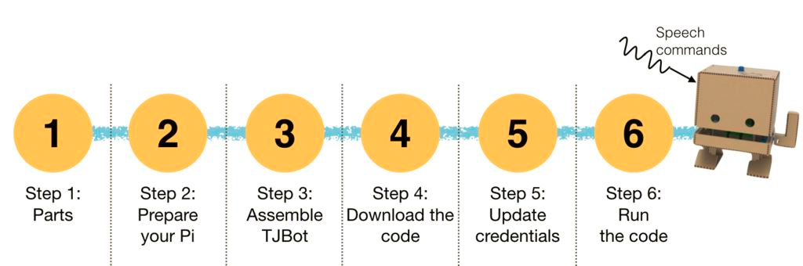
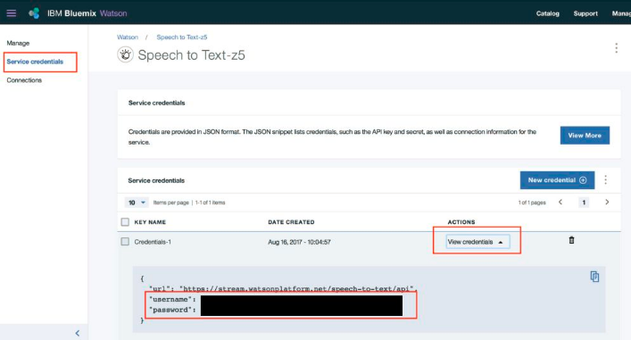
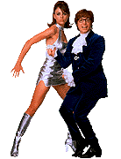
Recipe: Use Your Voice to Control a Light with Watson
Use Watson Speech to Text service to let you control the color of TJBot's LED with your voice. Say "turn the light green“ and TJBot will change the color of the LED to green.
Make sure you have configured your TJBot
If you experience issues, check recipe github site, check troubleshooting session, search on internet or call your friends!
Start here
Connect to Raspberry (# start a comment)
cd ~/Desktop/tjbot/recipes/speech_to_text
npm install #install recipe prerequisites
cp config.default.js config.js #copy default configuration
Create an instance of the Watson Text to Speech service.
Note Watson TTS authentication credentials.
Update configuration file with the credentials and run TJBot!
nano config.js #enter your credentials in the specified places.
Note: To save the changes in the file CTRL+o;
To leave the text editor CTRL+x
Sudo node stt.js #run TJBot with speech_to_text recipe
Now talk to your microphone to change the color of the LED. Say "turn the light blue" to change the light to blue. Try other colors, such as yellow, green, orange, purple, magenta, red, blue, aqua, and white. You can also say "turn the light on" or "turn the light off".
Funny?
Stop the program (CTRL+x).
Look the stt.js code.
Do you notice anything interesting?
Notes:
Easter Egg: We have hidden a disco party for you. Find the code for disco party in stt.js and uncomment the code (hint: there are two places that need to be uncommented). Now you can ask TJ to show you the disco lights by saying "Let's have a disco party"!
USE THIS HIDDEN FEATURE TO INTRODUCE TJBOT PROGRAMMING

Slide 16
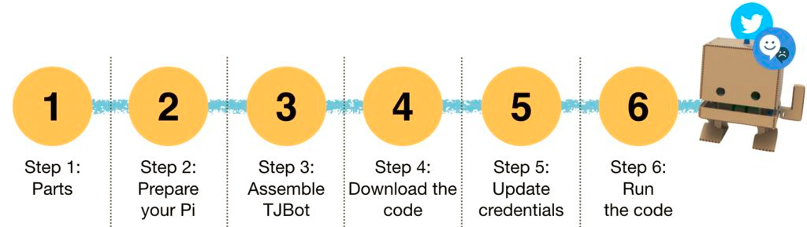
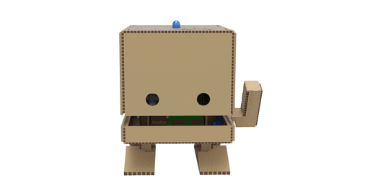
Recipe: Make Your Robot Respond to Emotions Using Watson
TJBot express emotions by the LED color, connecting to Twitter to analyze in real time the public sentiment about a given keyword (e.g. "education").
Start here
If you experience issues, check recipe github site, check troubleshooting session, search on internet or call your friends!
Make sure you have configured your TJBot
Connect to Raspberry (# start a comment)
cd ~/Desktop/tjbot/recipes/sentiment_analysis #enter in recipe directory
npm install #install recipe prerequisites
cp config.default.js config.js #copy default configuration
Create an instance of the Watson Tone Analyzer and note the authentication credentials.
Create a set of Twitter developer credentials and note the consumer key, consumer secret, access token key, and access token secret.
Update configuration file with the credentials and run TJBot!
nano config.js #enter your credentials in the specified places, (optional, change the monitored keyword editing exports.sentiment_keyword) Note: To save the changes in the file CTRL+o; To leave the text editor CTRL+x
Sudo node sentiment.js #run TJBot with sentiment_analysis recipe
At this point, TJBot will begin listening to Twitter for tweets containing the specified keyword. It may take some time to collect enough tweets, so please be patient. You can also check console output to understand what TJBot is doing ;)
Colors to sentiments: Anger (Red), Joy (Yellow), Fear (Magenta), Disgust (Green), Sadness (Blue). You can also change the colors in shineForEmotion() function.

Slide 17
Some of the Featured recipes created by TJBot community
Expressing Emotions
Build a TJBot That Cares by J.Zheng. Puts a voice interface onto TJBot, then gives it the ability to converse and understand your emotional tones.
Twitter Wave by J.Weisz. An enhancement of the standar Sentiment Analysis recipe. This one adds options to wave and announce when the sentiment for a topic changes.
Reporting Weather, time, news, sports
TJ Weather by S.Bhat. Use TJBot as a personal weather station.
weatherbot by D.Lane. TJBot as a weatherbot. The angle of his arm shows you forecasted temperature and his head lights up if it will rain!
Tell the time by D.Cummins. Build a robot that can tell the time in different cities.
Thomas: A TJBot News Grabber by T.Bakshi. Build a chatbot that can report the news. It uses Discovery, Conversation, Natural Language Understanding, Knowledge Studio, Speech to Text, and Text to Speech.
SportsBuddy Use the SportsBuddy to chat about your favorite MLB team and receive news and standings using Twilio.
TJ Calendar by D.Gregory. A personal event planner based on your Google Calendar history
Vision Recognition
tjbot-visual-recognition by J.Zheng. socializing with classic monsters.
TJVision by V.Dibia. Recognize (and read out) content of images using the Watson Visual Recognition API.
VisualTJ (Node-Red based) by S.Vogelmann. A Node-RED based application to make your TJbot see and recognize the world.
TJBot-Visual by G.Newton. Connecting Conversation to Visual Recognition and make your TJbot see and recognize the world.
StockPots by S.Arnell. A simple application that recognises, and converses on different Knorr Stockpots based on Watson Cognitive capabilities.
Healthcare & Other
DoctorWat by WilsonWu. A desktop application for collecting user data that can reduce the information gap between doctors and patients.
TJBot Heptathalon by R.Mauer. Leverages IBM Watson Cognitive Services including - Conversation, Text to Speech, Speech to Text, Language Translator, Discovery, Tone Analyzer and Visual Recognition.
TJWave by Victor Dibia. Fun controller recipe for TJBot's servo arm.
TJDashboard by V.Dibia. Web interface to visualize underlying processes on TJBot.
TJDJ by V.Dibia. Fun speech-based app to get TJBot playing (and dancing to) song snippets using Watson Apis and the Spotify api.
You can also contribute with you own ones sending us email with a link to your repository and a demo video.
If you experience issues, check recipe github site, check troubleshooting session, search on internet or… call your friends!

Slide 18

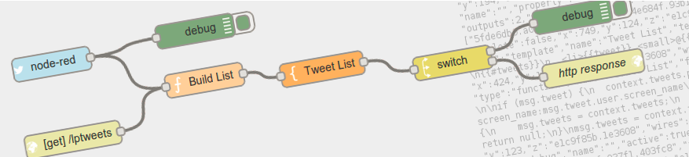
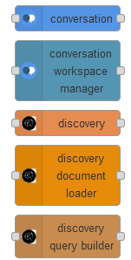
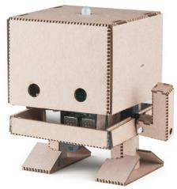
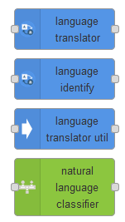

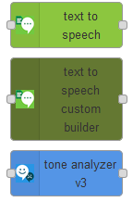
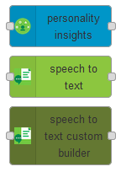
Compose TJBot behavior with «blocks»
Using blocks (aka nodes)is a very easy way to learn programming.
Node-RED is a flow-based development tool developed by Nick O’Leary and Dave Conway-Jones of IBM’s Emerging Technology Services group for wiring together hardware devices, APIs and online services as part of the Internet of Things. Node-RED provides a browser-based flow editor, which can be used to create JavaScript code.
I like it!
Add node-red-node-watson to palette to access IBM Watson Services available on Cloud.
Notes:
There’s a whole community out there
The runtime is built on Node.js. The flows created in Node-RED are stored using JSON.
Elements of applications can be saved or shared for re-use.
It was open-sourced in September 2013, now managed by JS Foundation.
Node-Red is now preinstalled on Raspian and it’s very easy to add new types of nodes (palette). E.g. Just add node-red-node-watson to palette to access IBM Watson Services available on Cloud.

Slide 19
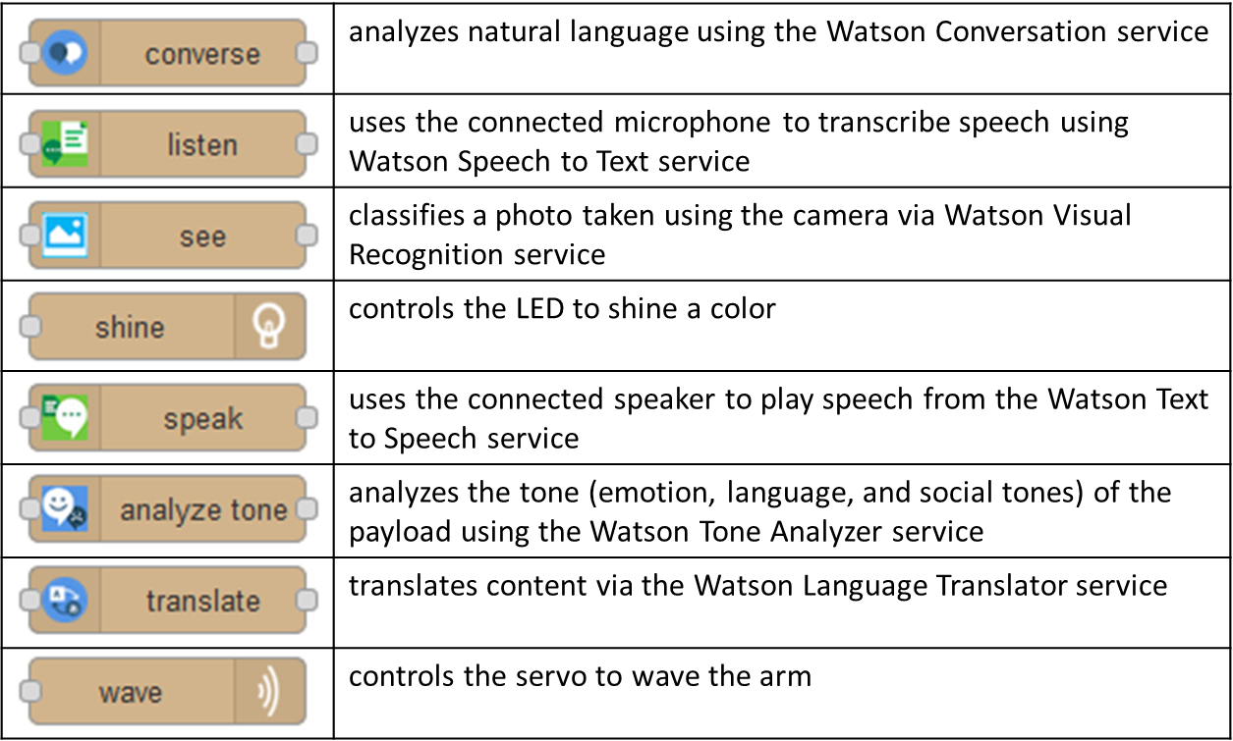
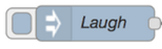
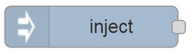

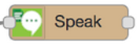
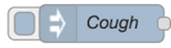
In August 2017, JeanCarl Bisson, created Node-RED nodes for TJBot
Laugh
Click
Cough
Click
Notes:
Nodes include:
analyze tone - analyzes the tone (emotion, language, and social tones) of the payload using the Watson Tone Analyzer service
converse - analyzes natural language using the Watson Conversation service
listen - uses the connected microphone to transcribe speech using Watson Speech to Text service
see - classifies a photo taken using the camera via Watson Visual Recognition service
shine - controls the LED to shine a color
speak - uses the connected speaker to play speech from the Watson Text to Speech service
take photo - captures a photo taken using the camera
translate - translates content via the Watson Language Translator service
wave - controls the servo to wave the arm

Slide 20
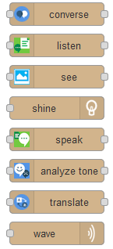
Setup Node-Red nodes for TJBot (1/2)
Upgrade Node-RED preinstalled with Raspbian Jessie using the command below.
bash <(curl -sL https://raw.githubusercontent.com/node-red/raspbian-deb-package/master/resources/update-nodejs-and-nodered)
Setup Node-Red to run when the Pi boots up, run:
sudo systemctl enable nodered.service
Then, install TJBot nodes from JeanCarl repository:
cd .node-red
mkdir nodes
cd nodes
git clone https://github.com/jeancarl/node-red-contrib-tjbot
cd node-red-contrib-tjbot
npm install
sudo nano /lib/systemd/system/nodered.service # some TJBot actions has to run as root so change User from pi to root
sudo systemctl daemon-reload
node-red-start # check node-red environment. Settings file should be at /root/.node-red/settings.js
node-red-stop
mkdir /home/pi/Desktop/tjbot/Pictures # place to host static content from top level URL
sudo nano /root/.node-red/settings.js. # Modify /root/.node-red/settings.js to point to the original Node-RED directory uncommenting and setting userDir and nodesDir variables as
userDir: '/home/pi/.node-red/’,
nodesDir: '/home/pi/.node-red/nodes’,
httpStatic: ‘/home/pi/Desktop/tjbot/Pictures/’
node-red-start
Point your browser to Node-Red URL and verify that nodes for TJBot are available.

Slide 21
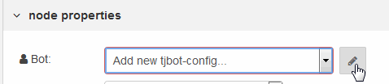
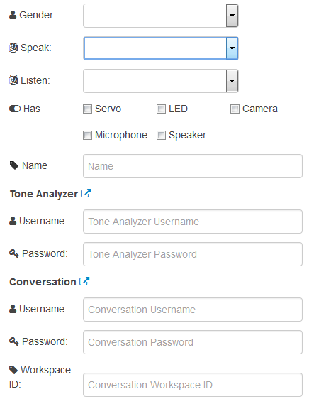
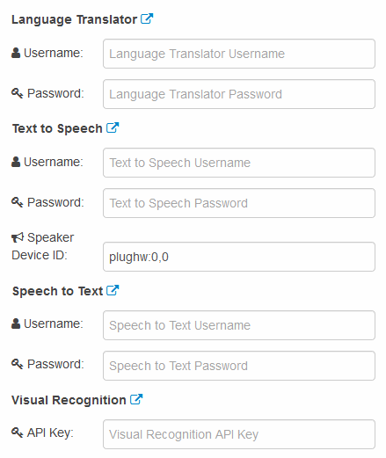
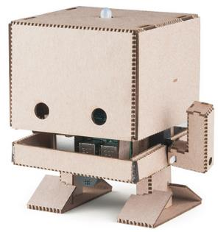
Setup Node-Red nodes for TJBot (2/2)
Your TJBot is unique! It has a gender, a preferred language to speak and listen. It could have a servo, a LED, a camera, a microphone and/or a speaker… and it has a NAME!
Now, drag a TJBot node in Node-Red and open it. Select “Add a new tjbot-config” and click the edit button.
My name is Bot, TJ Bot!
Direct link to IBM Cloud service
Multiple tjbot-config allowed!!!

Slide 22

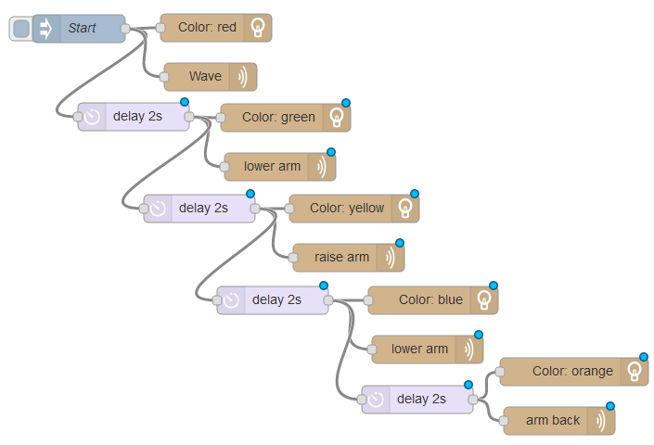


It’s your turn to play with nodes for TJBot
Now create a flow to follow this schema:
Turn LED red
Wave
Turn LED green
Lower Arm
Turn LED yellow
Raise Arm
Turn LED blue
Lower Arm
Turn LED orange
Backward Arm

Slide 23
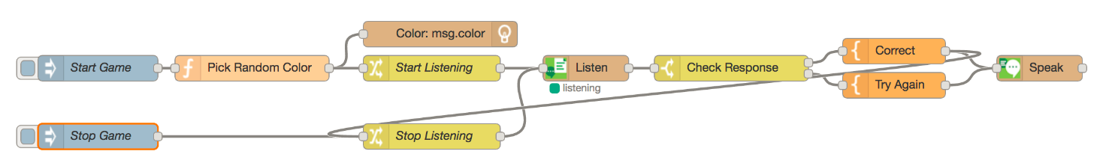
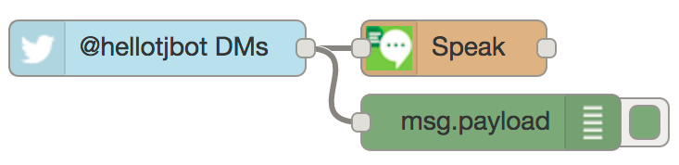
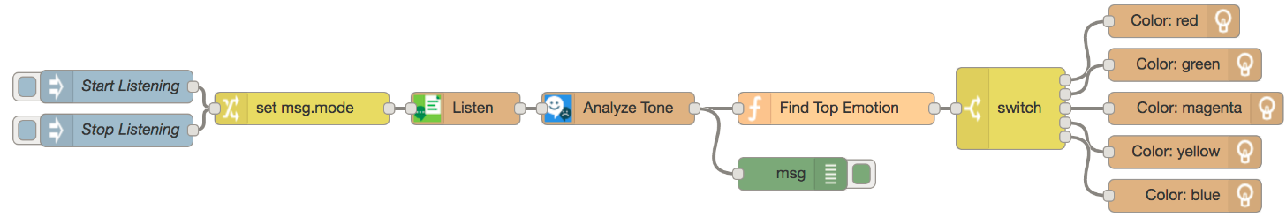
Examples with nodes for TJBot
In August 2017, JeanCarl Bisson, published a lot of examples around TJBot nodes ☺
Wave Shine Pulse Listen Speak See Translate Converse
Analyze Tone Analyze Emotion
Spell Words
Identify Colors Identify Objects
Identify Language Identify Language and Translate Shine Light Intent Analyze Language Tones Wave Intent
Be a Translator
Suggest A Lunch Spot Take a Photo and Tweet It Read Direct Messages Play Sounds
Say The Color Game
Measure CPU Temperature Say Weather Report Speak Headlines Send a Text Message
Notes:
Speaker tips: open Node-red and create basic examples with students

Slide 24
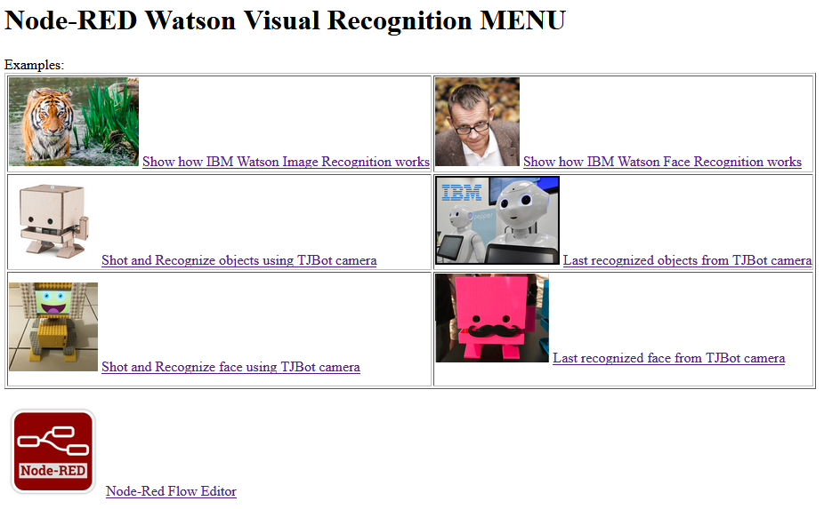
A very simple Node-Red web application running on TJBot to demo IBM Watson and TJBot services
Working on! Collect and share code
I’m running this web site!
I’m a tough robot!!!

Slide 25
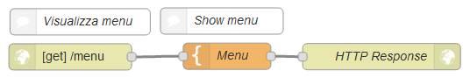
A very simple Node-Red web application on TJBot
under the hood (1/3)
Too Easy! I can do it!
Notes:
<html><head><title>MENU - Visual recognition Examples FM with ASLTJBot</title></head><body><h1>Node-RED Watson Visual Recognition MENU</h1><p>Examples:<br/><table border='1'><tr> <td> <img src="https://images.pexels.com/photos/145939/pexels-photo-145939.jpeg" height='100'/> <a href="/reco">Show how IBM Watson Image Recognition works</a><br/> </td> <td> <img src="https://www.nature.com/polopoly_fs/7.41086.1481708999!/image/feature1.jpg_gen/derivatives/landscape_630/feature1.jpg" height='100'/> <a href="/faces">Show how IBM Watson Face Recognition works</a><br/> </td></tr><tr> <td> <img src="https://cdn.sparkfun.com//assets/parts/1/2/5/8/8/14515-04.jpg" height='100'/> <a href="/shot">Shot and Recognize objects using TJBot camera</a><br/> </td> <td> <img src="http://www.rttnews.com/ArticleImages/USTopStories/2016/December/IBM-Robot-122916-lt.jpg" height='100'/> <a href="/what">Last recognized objects from TJBot camera</a><br/> </td></tr><tr> <td> <img src="http://aiclubs.org/uploads/1/0/7/3/107309405/published/img-5972.jpeg?1510622717" height='100'/> <a href="/knock">Shot and Recognize face using TJBot camera</a><br/> </td> <td> <img src="https://ibmtjbot.github.io/images/3dprint.jpg" height='100'/> <a href="/who">Last recognized face from TJBot camera</a><br/><br/> </td></tr></table><br/><img src="https://ih0.redbubble.net/image.144251032.5917/sticker,220x200-bg,ffffff-pad,220x200,ffffff.jpg" height='100'/><a href="/">Node-Red Flow Editor</a><br/></p></body></html>

Slide 26
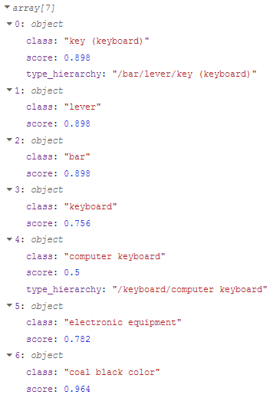
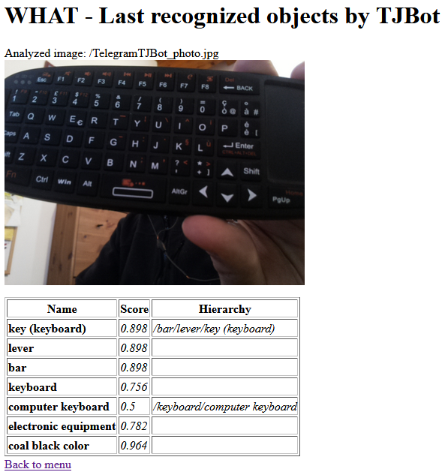
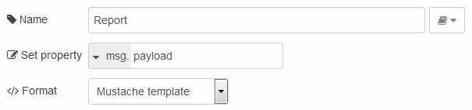
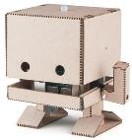
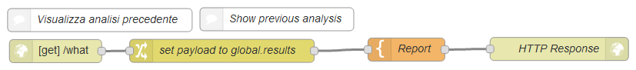
A very simple Node-Red web application on TJBot under the hood (2/3)
[…]
<table border='1'> <thead><tr>
<th>Name</th>
<th>Score</th>
<th>Hierarchy</th>
</tr></thead>
{{#payload}}
<tr>
<td><b>{{class}}</b></td>
<td><i>{{score}}</i></td>
<td><i>{{type_hierarchy}}</i></td>
</tr>
{{/payload}}
</table>
[…]
Too Easy!
I like Mustache!

Slide 27
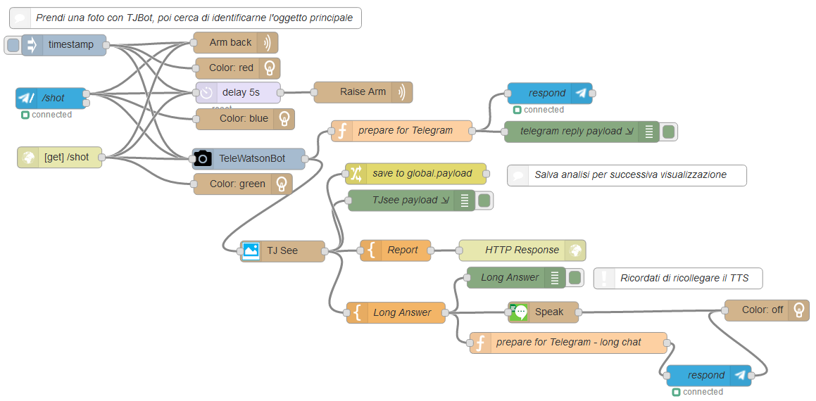


A very simple Node-Red web application on TJBot under the hood (3/3)
Web is boring!
Can you spot where I chat with a telegram bot?
And where I speak?
Collecting code

Slide 28


Program TJBot using Node.js
(aka Are you a Real Programmer or a Quiche Eaters?)
Using a computer language you can open a lot of new capabilities getting all the flexibility you need to bring your idea to life!
Programming is EASY (yes!), FUN (true story!) and could be learned at every AGE (Yes, Grandma, I’m talking to you!).
Do. Or do not. There is no try!!!
TJBot
Notes:
ITALIAN VERSION QUICHE EATERS: http://www.giun.it/bb/ciocori.htm (aka Mangiatori di Ciocorì)

Slide 29


Look at TJBot test.led.js program
'use strict';
const rl = require('readline-sync');
const TJBot = require('tjbot’); // load tjbot module
var tj = new TJBot( // instance new TJBot named tj
['led’], // it owns a LED
{log: {level: 'debug’}}, //debug level is VERBOSE
{}); // no Watson credentials needed
var colors = ['red', 'green', 'blue', 'orange', 'off'];
colors.forEach(function(color) {
tj.shine(color); // light up LED with desired color
var answer = rl.question('Did the LED turn ' + color + '? Y/N > ');
if (answer.toLowerCase() != 'y') {
throw new Error('expected the LED to turn ' + color + ', please check your LED wiring.');
}
});
LOOK: where is TJBot hardware defined?
LOOK: what’s the code to manage LED?
TRY: make a copy of test.led.js file and try to set the LED to your preferred color
Notes:
All code sample are Copyright 2016 IBM Corp. All Rights Reserved and Licensed under the Apache License, Version 2.0. Unless required by applicable law or agreed to in writing, software distributed under the License is distributed on an "AS IS" BASIS, WITHOUT WARRANTIES OR CONDITIONS OF ANY KIND, either express or implied. See the License for the specific language governing permissions and limitations under the License.
EXAMPLE CODE:
'use strict';
const rl = require('readline-sync');
const TJBot = require('tjbot’);
var tj = new TJBot( ['led’], {log: {level: 'debug’}},{});
tj.shine(‘blue’);

Slide 30

Look at TJBot test.servo.js program
REMIND: Stop Node-Red with node-red-stop command
'use strict';
const rl = require('readline-sync');
const TJBot = require('tjbot');
var tj = new TJBot(['servo'], {log: {level: 'debug'}}, {});
tj.armBack();
var answer = rl.question('Is TJBot\'s arm in the BACKWARD position? Y/N > ');
if (answer.toLowerCase() != 'y’) {throw new Error('expected arm to be in backward position, please check servo wiring.');}
tj.raiseArm();
answer = rl.question('Is TJBot\'s arm in the RAISED position? Y/N > ');
if (answer.toLowerCase() != 'y') {throw new Error('expected arm to be in raised position, please check servo wiring.');}
tj.lowerArm();
answer = rl.question('Is TJBot\'s arm in the LOWERED position? Y/N > ');
if (answer.toLowerCase() != 'y') {throw new Error('expected arm to be in lowered position, please check servo wiring.');}
tj.wave();
answer = rl.question('Did TJBot wave? Y/N > ');
if (answer.toLowerCase() != 'y’) {throw new Error('expected tj to wave, please check servo wiring.');}
Clear? Look at other test program (camera, speaker)
LOOK: How changed TJBot HW configuration?
LOOK: what’s the code to lower TJBot’s arm?
Notes:
All code sample are Copyright 2016 IBM Corp. All Rights Reserved and Licensed under the Apache License, Version 2.0. Unless required by applicable law or agreed to in writing, software distributed under the License is distributed on an "AS IS" BASIS, WITHOUT WARRANTIES OR CONDITIONS OF ANY KIND, either express or implied. See the License for the specific language governing permissions and limitations under the License.

Slide 31


Let’s put the things together
Now modify your code mixing TJBot’s commands to follow this schema:
Turn LED red
Wave
Turn LED green
Lower Arm
Turn LED yellow
Raise Arm
Turn LED blue
Lower Arm
Turn LED orange
Backward Arm
REMIND: Stop Node-Red with node-red-stop command
tj.shine('red');
tj.sleep(2000);
tj.wave();
tj.shine('green');
tj.sleep(2000);
tj.lowerArm();
tj.shine('yellow');
tj.sleep(2000);
tj.raiseArm();
tj.shine('blue');
tj.sleep(2000);
tj.lowerArm();
tj.shine('orange');
tj.sleep(2000);
tj.armBack();
tj.shine('off');
…
var tj = new TJBot(['led','servo'],{log:{level: 'debug'}},{});
tj.shine('red');
tj.wave();
tj.shine('green');
tj.raiseArm();
tj.shine('blue');
tj.lowerArm();
tj.shine('yellow');
tj.armBack();
THINK: Why it doesn’t work as expected?
TIPS: How do you realize it with TJBot nodes?
setTimeout(function() { tj.wave(); tj.shine('green'); }, 2000);
setTimeout(function() { tj.lowerArm();tj.shine('yellow'); }, 4000);
setTimeout(function() { tj.raiseArm();tj.shine('blue'); }, 6000);
setTimeout(function() { tj.lowerArm();tj.shine('orange'); }, 8000);
setTimeout(function() { tj.armBack(); tj.shine('off'); }, 10000);
Notes:
All code sample are Copyright 2016 IBM Corp. All Rights Reserved and Licensed under the Apache License, Version 2.0. Unless required by applicable law or agreed to in writing, software distributed under the License is distributed on an "AS IS" BASIS, WITHOUT WARRANTIES OR CONDITIONS OF ANY KIND, either express or implied. See the License for the specific language governing permissions and limitations under the License.

Slide 32

Zero to Master in TJBot programming (1/2)
const TJBot = require('tjbot’) statement leverages on tjbotlib, a Node.js library that abstracts basic functions for TJBot. It’s the core of everything and can be used (and even modified or expanded) to create your own robot. It’s downloaded and activated during TJBot setup with npm install --save tjbot command.
Create your TJBot with the constructor function TJBot(hardware, configuration, credentials), as shown in previous examples.
Valid options for hardware are: camera, led, microphone, servo, and speaker.
TJBot has several configuration options as described here. The most common options are: robot.name, robot.gender, listen.language, speak.language and verboseLogging. Additional advanced configuration options are available.
The credentials object expects credentials to be defined for each Watson service needed by your application. Most services expect a username and password, although some (e.g. visual_recognition) expect an API key.

Slide 33

Zero to Master in TJBot programming (2/2)
A description of the public TJBot API is given below.
tj.sleep(msec): Sleeps for the given number of milliseconds.
tj.analyzeTone(text): Analyzes the given text for the presence of emotions.
tj.converse(workspaceId, message, callback): Takes a conversational turn in the Conversation service.
tj.listen(callback): Opens the microphone and streams data to the speech_to_text service.
tj.pauseListening(): Pauses listening.
tj.resumeListening(): Resumes listening.
tj.stopListening(): Stops listening.
tj.see(): Returns a list of objects seen and their confidences.
tj.recognizeObjectsInPhoto(filePath): Returns a list of objects seen and their confidences in the given photo.
tj.read(): Returns a list of text strings read by TJBot.
tj.recognizeTextInPhoto(filePath): Returns a list of text strings read by TJBot in the given photo.
tj.takePhoto(targetPath): Takes an argument of the path targetPath where the image file should be saved.
tj.shine(color): Shines the LED the specified color.
tj.pulse(color, duration): Pulses the LED the given color (e.g. fades in and out to the given color).
tj.shineColors(): Returns an array of all of the colors that TJBot understands.
tj.randomColor(): Selects a random color from the array returned by tj.shineColors().
tj.speak(message): Speaks the given message using text_to_speech.
tj.play(soundFile): Plays the given sound file.
tj.translate(text, sourceLanguage, targetLanguage): Translates the given text from the source language to the target language.
tj.identifyLanguage(text): Identifies the language in which the text was written.
tj.isTranslatable(sourceLanguage, targetLanguage): Returns a Promise that resolves to true if there exists a translation model between the source language and the target language.
tj.armBack(): Causes TJBot to move its arm backward (like a wind-up for a pitch).
tj.raiseArm(): Causes TJBot to raise its arm to the upward position.
tj.lowerArm(): Causes TJBot to lower its arm to the downward position.
tj.wave(): Causes TJBot to wave the arm once (up-down-up).
Maryam Ashoori,
‘Cool Things Czar’
IBM Research
“I’m part computer scientist, part user experience analyst, and part interface artist.”

Slide 34


Expanding TJBot capabilities (1)
Lisa Waugh altered TJBot to Use Two Neopixel RGB LEDs
Wired each led directly to the pi for 3.3v and ground.
First led is wired to data in (pin 12).
Wired the first led Data OUT to the second led Data IN.
Note: The 3.3V pin could manage up to 3 RGB LEDs.
1-Find line # 231 this._led.init(1);
change the 1 to a 2 so you have this._led.init(2);
2-Find line # 914 var colors = new Uint32Array(1);
change the 1 to a 2 so you have var colors = new Uint32Array(2);
3-Duplicate line 915
change the duplicated line from colors[0] to colors[1]
you should have both of these lines now
colors[0] = parseInt(grb);
colors[1] = parseInt(grb);
4-Save the file
5-Run your recipe to test
Please edit tjbot.js very carefully.
These changes have to be made in local copy of tjbot.js and it will be wiped out anytime you do an npm install or npm rebuild. You will have to make this change for each recipe you want to use two leds with.

Slide 35



Expanding TJBot capabilities (2)
Speak on distance by Duy Nguyen
This recipe provides steps to build a simple robot which knows distance between itself and objects near by. If any object gets closer than 10 cm, the robot will speak up asking for privacy.
Hardware requirements
A Raspberry Pi Model B 3
HC-SR04 distance sensor
1K resistor
Speaker. Author used an Anker A7910 speaker
Author extends a TJBot text to speech program coding how to manage distance sensor (init, start and measure distances).
Everything is done using Node.js.
Simple, easy to manage, works like a charm!
THINK: how could it be done in a different way?
Notes:
(if required) change node_modules/mmm-usonic/lib/usonic.js library to manage HARDWARE BCM2835
Change Line 29 --->>> if ((hardware === 'BCM2708') || (hardware === 'BCM2835')) {

Slide 36


Expanding TJBot capabilities (3)
TJBot Drives! By Paul G Crumley
This project will give TJBot the ability to control an RC truck to provide mobility.
It uses an inexpensive RC vehicle as some hardware modifications are required and one might not want to open the covers on an expense device. A soldering iron and some basic electronic experience will help with this project but with care this can be done as a first experience with both. For this project a wireless headset is recommended rather than the simple USB microphone as noise from the vehicle can interfere with the voice commends.
Materials Needed:
TJBot
A suitable RC vehicle (ones that use two 1.5 volt batteries are preferred)
Soldering iron and solder
Several proto-board jumpers (one end will be cut off)
Wireless headset (suggested, rather than simple USB microphone)
Once you have the RC vehicle you can look inside the controller to gain a better understanding of what else is needed to connect it to the Raspberry Pi in the TJBot.
Notes:
Video https://youtu.be/AAlcMZAQDOI

Slide 37

Expanding TJBot capabilities (4a)
Finally, I got a second arm (and more stuff)!
Added two additional hardware capabilities:
leftArm
rightArm
Added additional TJBot API (and supporting functions):
tj.waveArms()
tj.waveLeftArm()
tj.waveRightArm()
tj.leftArmBack()
tj.rightArmBack()
tj.raiseRightArm()
tj.raiseLeftArm()
tj.lowerLeftArm()
tj.lowerRightArm()
tj.recognize()
tj.shineLeftRight()
#Installation:
> cd /home/pi/Desktop
> git clone https://github.com/fmanclossi/tjbotTwoArmsTwoLEDs
Now, Replace tjbot.js library where needed
(I know, it’s an awful way to install software)
Wired TJBot servo motor to PIN 26 (BCM 7) – Left Arm
Wired a second servo motor to PIN 22 (BCM 25) – Right Arm
Chained a second RGB LED (as described in previous slide)
Also, added (not integrated) a HC-SR04 Ultrasonic sensor.
Please edit or use this customized tjbot.js library very carefully.
These changes are uncommitted changes of master tjbot.js library and they will be wiped out anytime you do an npm install or npm rebuild. You will have to make substitute original tjbot.js with this customization for each recipe you want to use it.
Faccina («Little face»)

Slide 38



Expanding TJBot capabilities (4b) - wiring
Wired each led directly to the pi for 3.3v and ground.
First led is wired to data in (pin 12).
Wired the first led Data OUT to the second led Data IN.
Kept servo wired as original arm wired to PIN 26 (BCM/GPIO 7) – Left Arm
Wired a second servo motor to PIN 22 (BCM/GPIO 25) – Right Arm
Wired HC-SR04 to PIN 21 (GPIO 09 – Trigger) and PIN 23 (GPIO 11 – Echo)
A little breadboard helps wiring from base to head
I made some change to default TJBot Kit:
Raspberry Pi 3 Model B
Raspberry Pi Camera Board v2
Micro Servo
Mini USB Microphone
Mini External USB Stereo Speaker
Female/Female Jumper Wires - 20 x 3"
Female/Male 'Extension' Jumper Wires - 20 x 3"
5V 2.4A Switching Power Supply
DC5V Diffused round hat RGB LED with WS2811
16GB Card with NOOBS 2.1
if you’ll plan to use LED and audio -> USB Audio Adapter
Different RGB WS2811 LED could be use, in case carefully verify PIN assignment
Layout is DIFFERENT from standard TJBot LED:
Pin1 = D.Out
Pin2 = 5V
Pin3 = GND
Pin4 = D.In
Raspberry ports are on the back and bottom left leaving space to connect BIG adapters and cable
Notes:
It's very important to make sure you connect the LED to the right pins, otherwise you may damage your LED or the Pi.
Then start with the GND, which is the longest, or the 2nd leg from the right. Connect it with pin # 6 on the board
Then connect Data (the leftmost leg) with pin # 12 on the board
Finally, connect + 3.3V (leg 2 from the left) with pin # 1.
IF YOU USE A DIFFERENT LED, CAREFFULLY VERIFY LEGs
e.g. With Aliexpress provedr I used, GND and 5V are switched… one LED damaged ☹
In my case,:
LED1:
Flat on right, legs from right to left:
Leg1-> Leg4 LED2
Leg2-> PIN 1 (I used 3,3V instead of 5V)
Leg3-> PIN 6
Leg4-> PIN 12
LED2:
Leg1-> empty
Leg2-> PIN 17 (I used 3,3V instead of 5V)
Leg3-> PIN 9
Leg4-> from Leg1 LED1
Servo motor
5V -> PIN 2
GND = PIN 14
DATA = PIN 26

Slide 39






Expanding TJBot capabilities (4c) – Node-Red
I got additional Node-Red capabilities, too!
Added Left and Right Arm hardware capabilities in TJBot configuration
Added an additional TJBot node (sleep) and modified JeanCarl’s nodes (applying modify TJBot library).
HC-SR04 Ultrasonic sensor is manage by node-red-node-pisrf available in Node-Red palette (it requires Physical PINs values, not GPIO).
Could be useful to install node-red-contrib-camerapi, too.
Node | Change | Notes
sleep | Added | Make TJBot take a snap Inputs: sleeptime (number) - the length of time in milliseconds to sleep
see | Changed | Added “recognize” feature. This mode returns a list of person details and confidence scores.
shine | Changed | Now, It’s possible to choose different colors for left and right LEDs
wave | Changed | Now, It’s possible to define motion for a specific arm (left or right)

Slide 40
Setup Expanded nodes for TJBot (4d/1)
Install modified TJBot library as described in previous slide.
Upgrade Node-RED preinstalled with Raspbian Jessie using the command below.
bash <(curl -sL https://raw.githubusercontent.com/node-red/raspbian-deb-package/master/resources/update-nodejs-and-nodered)
Setup Node-Red to run when the Pi boots up, run:
sudo systemctl enable nodered.service
Then, install TJBot nodes from EXPANDED TJBot Nodes repository:
cd .node-red
mkdir nodes
cd nodes
git clone https://github.com/fmanclossi/node-red-contrib-tjbotTwoArmsTwoLeds
cd node-red-contrib-tjbotTwoArmsTwoLeds
npm install
mv node_modules/tjbot/lib/tjbot.js node_modules/tjbot/lib/tjbot.js.orig #just in case you want to go back to official distro
cp /home/pi/Desktop/tjbotTwoArmsTwoLEDs/lib/tjbot.js node_modules/tjbot/lib/ #change path if it’s not on Desktop
sudo nano /lib/systemd/system/nodered.service # some TJBot actions has to run as root so change User from pi to root
sudo systemctl daemon-reload
node-red-start # check node-red environment. Settings file should be at /root/.node-red/settings.js
node-red-stop
mkdir /home/pi/Desktop/httpStatic # place to host static content from top level URL
sudo nano /root/.node-red/settings.js. # Modify /root/.node-red/settings.js to point to the original Node-RED directory uncommenting and setting userDir and nodesDir variables as
userDir: '/home/pi/.node-red/’,
nodesDir: '/home/pi/.node-red/nodes’,
httpStatic: ‘/home/pi/Desktop/httpStatic/’
node-red-start
IMPORTANT: Follow all these instructions only if you don’t already setup TJBot’s node as described in JeanCarl work. If you already setup them, move to the next slide.
Point your browser to Node-Red URL (port 1880) and verify that extended nodes for TJBot are available.

Slide 41


Setup Expanded nodes for TJBot (4d/2)
Install modified TJBot library as described in previous slide.
Save your work, Clear Node-Red flows and deploy empty environment.
Then, install TJBot nodes from EXPANDED TJBot Nodes repository:
cd .node-red/nodes
mkdir ../backup
mv node-red-contrib-tjbot ../backup #just to keep previous environment
git clone https://github.com/fmanclossi/node-red-contrib-tjbotTwoArmsTwoLeds
cd node-red-contrib-tjbotTwoArmsTwoLeds
npm install
mv node_modules/tjbot/lib/tjbot.js node_modules/tjbot/lib/tjbot.js.orig #just in case you want to go back to official distro
cp /home/pi/Desktop/tjbotTwoArmsTwoLEDs/lib/tjbot.js node_modules/tjbot/lib/ #change path if it’s not on Desktop
sudo nano /lib/systemd/system/nodered.service # some TJBot actions has to run as root so change User from pi to root
sudo systemctl daemon-reload
node-red-start # check node-red environment. Settings file should be at /root/.node-red/settings.js
node-red-stop
mkdir /home/pi/Desktop/httpStatic # place to host static content from top level URL
sudo nano /root/.node-red/settings.js. # Modify /root/.node-red/settings.js to point to the original Node-RED directory uncommenting and setting userDir and nodesDir variables as
userDir: '/home/pi/.node-red/’,
nodesDir: '/home/pi/.node-red/nodes’,
httpStatic: ‘/home/pi/Desktop/httpStatic/’
node-red-start
IMPORTANT: Follow all these instructions only if you already setup TJBot’s node as described in JeanCarl work.
Point your browser to Node-Red URL (port 1880) and verify that extended nodes for TJBot are available.

Slide 42


Expanding TJBot capabilities (4e) - example
Faccina introduces itself if distance is in 100-80cm range. If distance is less than 20cm, it shout and waves asking for privacy (as in this hack)
Audio files are already stored in Raspberry and internet connection is not required (useful for demo environment)

Slide 43



More recipes to extend TJBot with new Hardware
Control a lamp with TJBot by Nguyen Van Duy. This recipe guides you through how to make your TJBot listen to your commands and turn on, turn off a lamp (yes, a real lamp).
tjbot-striplight by Justin Weisz. Adds support for NeoPixel RGB LED strip light.
twitter-striplight by Justin Weisz. Twitter monitoring with strip light support
Controling Devices/Tools with TJBot
TJBot can control electrical devices by Paul G Crumley
Run a million volt Tesla coil by John Cohn
Control TV with TJBot by F.Sabba, L.Bartoloni, M.Mazzanti and V.Amadori (from Università Politecnica delle Marche). TJbot is a "zapping" friend connected to internet and TV, allowing elderly people to navigate on the web like on TV.
You can also contribute with you own ones sending us email with a link to your repository and a demo video.
If you experience issues, check recipe github site, check troubleshooting session, search on internet or… call your friends!
It’s your turn!!!
Welcome to the TobyJnr, an evolution of TJBot. It is driven entirely by Node-RED running on the Raspberry Pi inside TobyJnr and also has an optional SenseHAT. The SenseHAT allows TobyJnr to be controlled via the joystick on the SenseHAT. It also provides environment and motion sensors and an 8x8 LED panel for feedback to the user.

Slide 44


Swift Playground for interacting with TJBot!
Interact with TJBot from your iPad in this Swift playground book! This project showcases how Swift can be used to interact with IoT devices such as TJBot.
Learn how to program TJBot and make him come to life using IBM Watson services such as Speech to Text, Visual Recognition, Language Translator, and more!
The TJBot playground book communicates with your TJBot using Bluetooth Low Energy (BLE), so you can program your TJBot while sitting next to him!
No robot, no problem! You can still explore the first two chapters of this playground without a physical TJBot.
Notes:
The easiest way to get this playground on your iPad is to download the latest release to your Mac and then use AirDrop to copy the playground to your iPad. After downloading, right click the “TJBot.playgroundbook” file, and choose “Share > AirDrop.” A list will open up which should show your iPad. Click your iPad to transfer the Playground.
Note: Make sure AirDrop on your iPad is turned on!
In addition to this playground book, you will need to install the tjbot-daemon project on your TJBot. Please refer to the installation instructions to learn how to set up your TJBot with the daemon.

Slide 45

Learn How to Code a Robot with the TJBot Simulator
This TJBot simulator provides an emulated environment where you can control a virtual TJBot. It has been built to support basic code samples and gives just some of the freedom that programming on the real TJBot provides. However, this simulator doesn't provide all the same things the Node.js environment running on the Raspberry Pi does. Enjoy!

Slide 46


Troubleshooting – USB Sound
You should connect the USB speaker and the USB microphone (or USB sound card) then power on your system. Plugging in USB devices in a different order can break the configuration.
Verify the USB sound devices, enter the command aplay -l. **** List of PLAYBACK Hardware Devices **** card 1: Audio [USB Audio], device 0: USB Audio [USB Audio] Subdevices: 1/1 Subdevice #0: subdevice #0
here you can see the USB audio device is on card 1, device 0.
Once you have identified the USB card and device numbers you can configure the sound card using the Raspberry Pi GUI. Right click the speaker icon then select USB Device Settings.
Select each of the devices in turn then hit the 'Select Controls..' button and select all available controls. Repeat if you have another USB audio device - you should have enabled controls for Playback and Capture. Ensure that both the speaker and microphone are enabled and the volume is set to an appropriate level.
You need also to go and manually change the configuration that has been set to enable a plugin which will ensure that the correct audio format is sent to the hardware. The plugin cannot be enabled using the GUI, you need to open a terminal (either within the GUI or via ssh) and edit the file ~/.asoundrc and change the pcm entry to reflect the card number and device number from the aplay -l command (hw:1,0).
pcm.!default { type hw card 1 }
ctl.!default { type hw card 1 }
pcm.!default { type plug slave { pcm "hw:1,0" } }
Testing the audio settings
You should hear audio when running both commands: aplay /usr/lib/libreoffice/share/gallery/sounds/cow.wav
sudo aplay /usr/share/sounds/alsa/Front_Center.wav The test audio files will be on your raspberry Pi if you have followed the standard setup of Raspbian.
Notes:
IMHO audio has to work even if run as root (sudo)

Slide 47


Troubleshooting – internal audio jack
We suggested to deactivated the internal speaker to avoid interferences with LED. If you want to reverse this change (e.g. You don’t use LED) run:
sudo rm -f /etc/modprobe.d/tjbot-blacklist-snd.conf
Unplug the led, turn on the speaker
sudo reboot
If you want to disable the audio kernel modules, disable sound kernel modules with the following command:
sudo cp ~/Desktop/tjbot/bootstrap/tjbot-blacklist-snd.conf /etc/modprobe.d/
sudo reboot
Note: This command assumes you have cloned the tjbot git repository to your Desktop. If you have cloned it to a different directory, be sure to update the path in the above command.

Slide 48

Troubleshooting – misc
Q1- I got "error: the speech_to_text service returned an error. Error: Session timed out.“
A1- set timeout under the listen configuration parameters

Slide 49



TJ turning to a parrot in Brazil
photo by Maryam Ashoori
Ready, Steady… Enjoy!
TJBot Laura
By ADRIANA Pellegrini Furnielis
Helper Droids
Science and Star Wars
All the credits belongs to TJBot team and fans around the world. I got everything I can from your activities.
Thanks to everyone that will update, integrate and fix up all the things I’ve understood or missed.
Please share you updates, and let TJBot grown up! Ferruccio Manclossi, March 2018

